Slide 1
Data Mining Anomaly Detection
Lecture Notes for Chapter 10
Introduction to Data Mining
by
Tan, Steinbach, Kumar

Slide 2
Anomaly/Outlier Detection
What are anomalies/outliers?
The set of data points that are considerably different than the remainder of the data
Variants of Anomaly/Outlier Detection Problems
Given a database D, find all the data points x ∈ D with anomaly scores greater than some threshold t
Given a database D, find all the data points x ∈ D having the top-n largest anomaly scores f(x)
Given a database D, containing mostly normal (but unlabeled) data points, and a test point x, compute the anomaly score of x with respect to D
Applications:
Credit card fraud detection, telecommunication fraud detection, network intrusion detection, fault detection

Slide 3
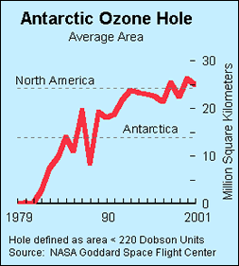
Importance of Anomaly Detection
Ozone Depletion History
In 1985 three researchers (Farman, Gardinar and Shanklin) were puzzled by data gathered by the British Antarctic Survey showing that ozone levels for Antarctica had dropped 10% below normal levels
Why did the Nimbus 7 satellite, which had instruments aboard for recording ozone levels, not record similarly low ozone concentrations?
The ozone concentrations recorded by the satellite were so low they were being treated as outliers by a computer program and discarded!
Sources: http://exploringdata.cqu.edu.au/ozone.html http://www.epa.gov/ozone/science/hole/size.html

Slide 4
Anomaly Detection
Challenges
How many outliers are there in the data?
Method is unsupervised
Validation can be quite challenging (just like for clustering)
Finding needle in a haystack
Working assumption:
There are considerably more “normal” observations than “abnormal” observations (outliers/anomalies) in the data

Slide 5
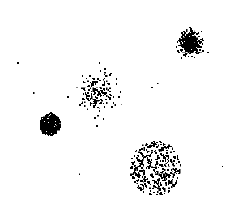
Anomaly Detection Schemes
General Steps
Build a profile of the “normal” behavior
Profile can be patterns or summary statistics for the overall population
Use the “normal” profile to detect anomalies
Anomalies are observations whose characteristics differ significantly from the normal profile
Types of anomaly detection schemes
Graphical & Statistical-based
Distance-based
Model-based

Slide 6
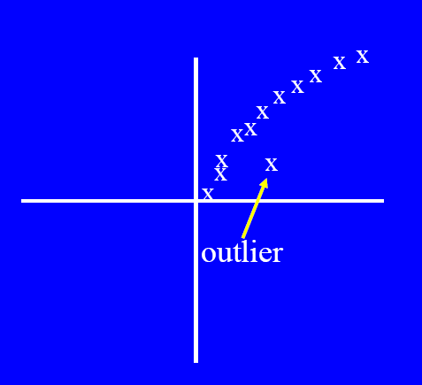
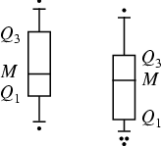
Graphical Approaches
Boxplot (1-D), Scatter plot (2-D), Spin plot (3-D)
Limitations
Time consuming
Subjective

Slide 7
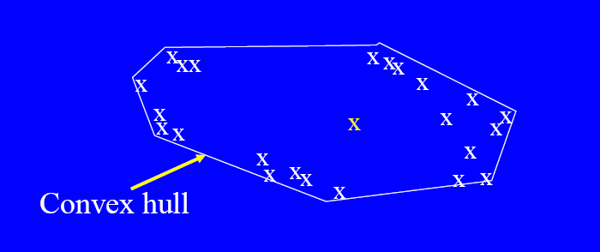
Convex Hull Method
Extreme points are assumed to be outliers
Use convex hull method to detect extreme values
What if the outlier occurs in the middle of the data?

Slide 8
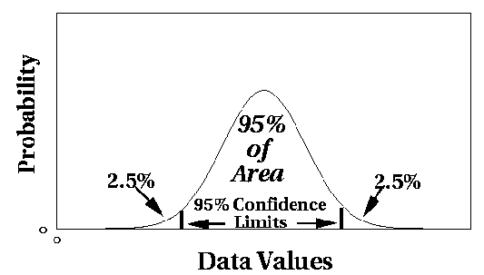
Statistical Approaches
Assume a parametric model describing the distribution of the data (e.g., normal distribution)
Apply a statistical test that depends on
Data distribution
Parameter of distribution (e.g., mean, variance)
Number of expected outliers (confidence limit)

Slide 9
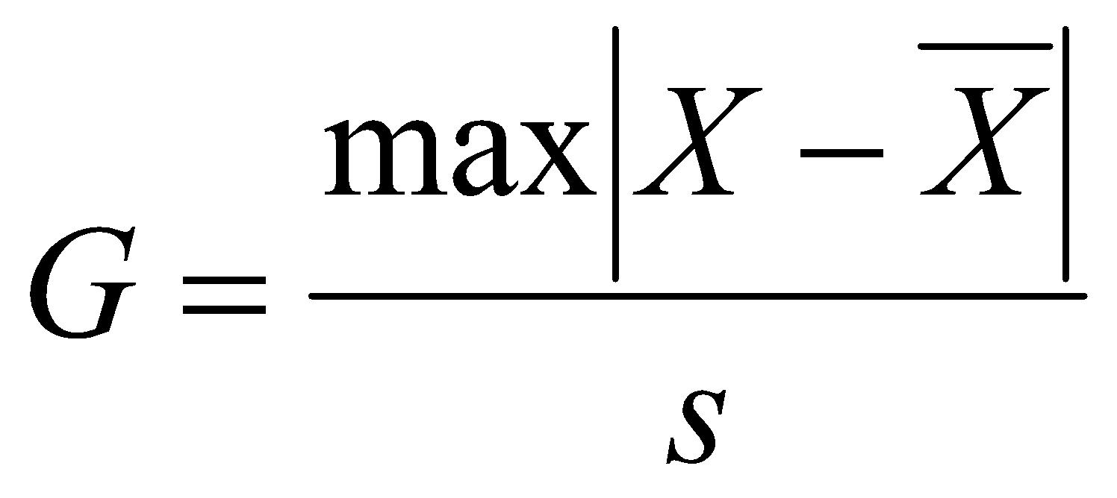
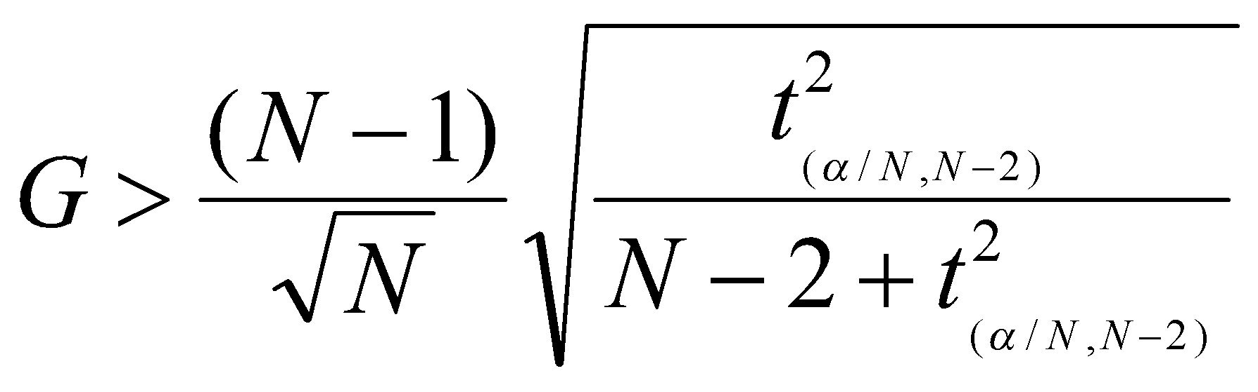
Grubbs’ Test
Detect outliers in univariate data
Assume data comes from normal distribution
Detects one outlier at a time, remove the outlier, and repeat
H₀: There is no outlier in data
H_{A}: There is at least one outlier
Grubbs’ test statistic:
Reject H₀ if:

Slide 10
Statistical-based – Likelihood Approach
Assume the data set D contains samples from a mixture of two probability distributions:
M (majority distribution)
A (anomalous distribution)
General Approach:
Initially, assume all the data points belong to M
Let L_{t}(D) be the log likelihood of D at time t
For each point x_{t} that belongs to M, move it to A
Let L_{t+1} (D) be the new log likelihood.
Compute the difference, Δ = L_{t}(D) – L_{t+1} (D)
If Δ > c (some threshold), then x_{t} is declared as an anomaly and moved permanently from M to A

Slide 11
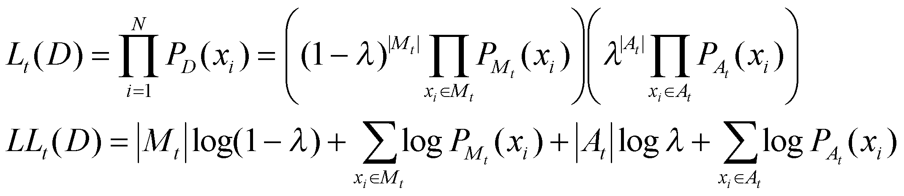
Statistical-based – Likelihood Approach
Data distribution, D = (1 – λ) M + λ A
M is a probability distribution estimated from data
Can be based on any modeling method (naïve Bayes, maximum entropy, etc)
A is initially assumed to be uniform distribution
Likelihood at time t:

Slide 12
Limitations of Statistical Approaches
Most of the tests are for a single attribute
In many cases, data distribution may not be known
For high dimensional data, it may be difficult to estimate the true distribution

Slide 13
Distance-based Approaches
Data is represented as a vector of features
Three major approaches
Nearest-neighbor based
Density based
Clustering based

Slide 14
Nearest-Neighbor Based Approach
Approach:
Compute the distance between every pair of data points
There are various ways to define outliers:
Data points for which there are fewer than p neighboring points within a distance D
The top n data points whose distance to the kth nearest neighbor is greatest
The top n data points whose average distance to the k nearest neighbors is greatest

Slide 15
Outliers in Lower Dimensional Projection
In high-dimensional space, data is sparse and notion of proximity becomes meaningless
Every point is an almost equally good outlier from the perspective of proximity-based definitions
Lower-dimensional projection methods
A point is an outlier if in some lower dimensional projection, it is present in a local region of abnormally low density

Slide 16

Outliers in Lower Dimensional Projection
Divide each attribute into φ equal-depth intervals
Each interval contains a fraction f = 1/φ of the records
Consider a k-dimensional cube created by picking grid ranges from k different dimensions
If attributes are independent, we expect region to contain a fraction f^{k} of the records
If there are N points, we can measure sparsity of a cube D as:
Negative sparsity indicates cube contains smaller number of points than expected

Slide 17
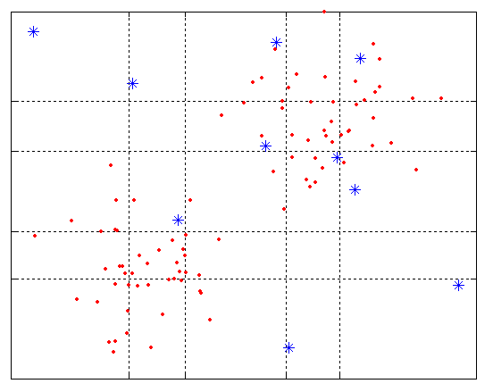
Example
N=100, φ = 5, f = 1/5 = 0.2, N × f² = 4

Slide 18
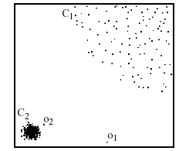
Density-based: LOF approach
For each point, compute the density of its local neighborhood
Compute local outlier factor (LOF) of a sample p as the average of the ratios of the density of sample p and the density of its nearest neighbors
Outliers are points with largest LOF value
In the NN approach, p₂ is not considered as outlier, while LOF approach find both p₁ and p₂ as outliers
p₂
×
p₁
×

Slide 19

Clustering-Based
Basic idea:
Cluster the data into groups of different density
Choose points in small cluster as candidate outliers
Compute the distance between candidate points and non-candidate clusters.
If candidate points are far from all other non-candidate points, they are outliers

Slide 20


Base Rate Fallacy
Bayes theorem:
More generally:

Slide 21
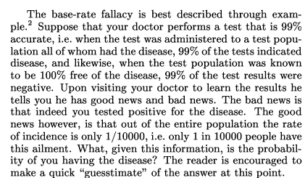
Base Rate Fallacy (Axelsson, 1999)

Slide 22


Base Rate Fallacy
Even though the test is 99% certain, your chance of having the disease is 1/100, because the population of healthy people is much larger than sick people

Slide 23
Base Rate Fallacy in Intrusion Detection
I: intrusive behavior, ¬I: non-intrusive behavior A: alarm ¬A: no alarm
Detection rate (true positive rate): P(A|I)
False alarm rate: P(A|¬I)
Goal is to maximize both
Bayesian detection rate, P(I|A)
P(¬I|¬A)

Slide 24



Detection Rate vs False Alarm Rate
Suppose:
Then:
False alarm rate becomes more dominant if P(I) is very low

Slide 25
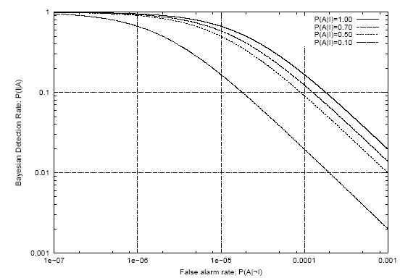
Detection Rate vs False Alarm Rate
Axelsson: We need a very low false alarm rate to achieve a reasonable Bayesian detection rate

